Slide 1
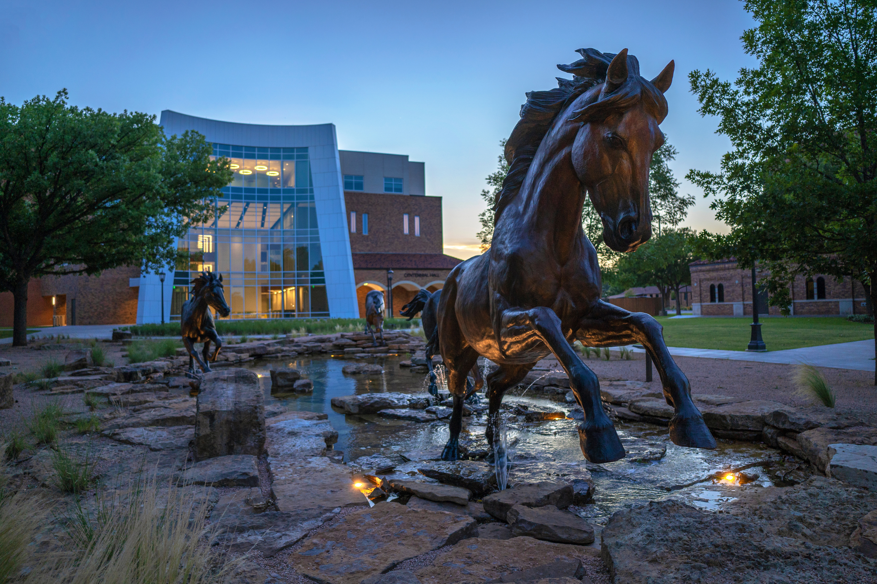



Slide 2
What is Financial Aid?
Money from a source, other than the family, to assist with the cost of attending college, which includes:
  Scholarships
  Grants
  Loans
  Employment
  Tuition Exemptions

Slide 3
What is the FAFSA?
“FREE Application for Federal Student Aid”
  A standard form that collects demographic and financial information about the student and family
  Information used to calculate the Student Aid Index (SAI) – formerly the EFC
  Students must complete FAFSA for each school year
  Colleges may set FAFSA filing deadlines
  Title IV School Code – MSU Texas is 003592; other school codes are available from your counselor or the FAFSA online search

Slide 4
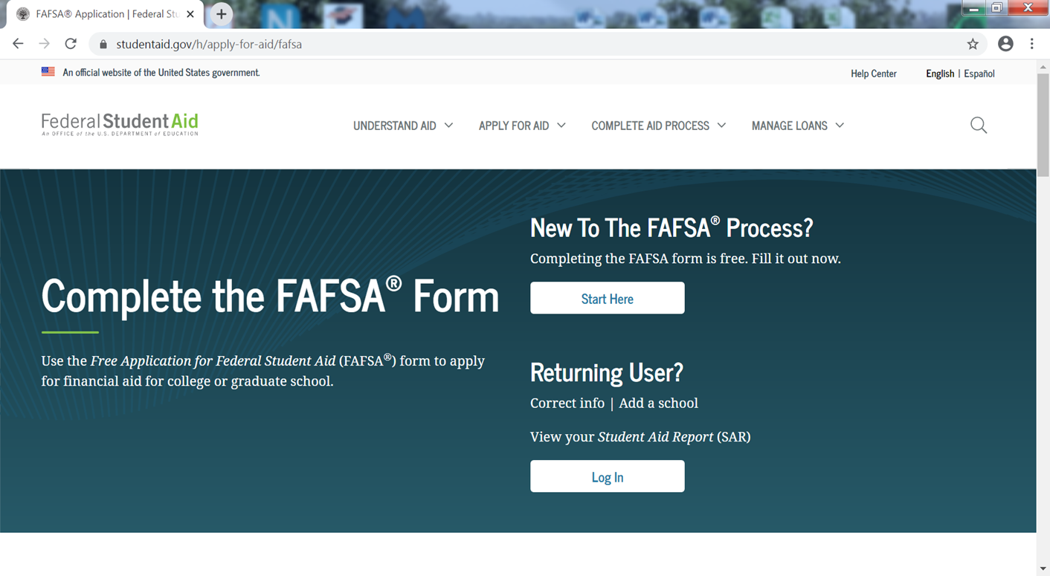
studentaid.ed.gov/sa/fafsa
FAFSA available December 31, 2023.

Slide 5
Submitting the FAFSA
“FREE Application for Federal Student Aid”
  Income Information: You will provide income information from 2022 income information via Future Act Direct Data Exchange (FADDX)
  Award Notification: Submission of your 2024-25 FAFSA application will allow us to determine your financial aid eligibility early as well.
  Know your school’s PRIORITY deadline date;
    MSU Texas = March 15 for Fall/Spring

Slide 6
Submitting the FAFSA
“FREE Application for Federal Student Aid”
  Contributor is any person required to provide information on the FAFSA. Such as student; parent/ other parent/partner.
  Federal Tax Information (FTI): Student/Parent 2022 income tax return will transfer onto the FAFSA while completing the application.
  Student/Parent/Contributor must provide consent and approval for FTI transfer. If no consent or approval, student is not eligible for aid.

Slide 7
IRS Tax Transcript Options
  Online – www.IRS.gov
    Click “Get Your Tax Record”
    Then click “Get Transcript Online”
    NOTE: be sure to request the IRS Tax Return Transcript, NOT the IRS Tax Account Transcript!
  By Mail – www.IRS.gov (5-10 calendar days)
    Click “Get Your Tax Record”
    Then click “Get Transcript By Mail”
    NOTE: be sure to request the IRS Tax Return Transcript, NOT the IRS Tax Account Transcript!
  By Phone - 1-800-908-9946
    5-10 calendar days
  Paper Request
    IRS Form 4506T
    Up to 10 calendar days

Slide 8
Signing the FAFSA
Apply for an FSA ID now!
  You will need a FSA ID to electronically sign your FAFSA. You can also check the results of your processed FAFSA, make corrections to your FAFSA, or print an electronic copy of your Student Aid Report (SAR).
  Go to studentaid.gov/fsa-id/create-account/account-info to apply.
  Students and parents of dependent students must apply!
  Each student must have his/her own FSA ID, but parents can have one FSA ID for multiple, dependent students.
  FSA ID's do not expire, so student and parent can use the same FSA ID's each year to complete the FAFSA electronically.
  Provide an email address to receive your FSA ID's quicker!

Slide 9
What is the TASFA?
Undocumented Students “SB 1528)
  This law permits some non-citizens to be classified as Texas residents for financial aid and admission purposes. Those students may receive
    In-state tuition
    Texas Financial Aid (NOT federal aid)
  Application
    Submit a Texas Application for State Financial Aid (TASFA) and submit to the financial aid office at the institution for processing
    collegeforalltexans.com

Slide 10
What is the Student Aid Index (SAI)?
  Formerly known as EFC (Expected Family Contribution)
  The amount of resources a student and his/her family may reasonably be expected to contribute toward the cost of education for an academic year
  *Stays the same regardless of college you choose, but is calculated with new information each new year you file the FAFSA
  *Calculated using data from the FAFSA and a pre-set federal formula

Slide 11
Grants
FREE MONEY! Does not have to be paid back.
  Federal Grants
    Pell Grant: 2023-2024 ranges from $784-$7,395 for full-time students. Amount based on SAI & enrollment status. Offered no more than 6 years!
    SEOG Grant: Limited amount of money; must be Pell-eligible & zero SAI (at MSU).
    TEACH Grant: for students seeking high needs fields; must be accepted into MSU Education program.
    U.S. Department of Veteran Affairs: GI Bill, Chapter 30, etc.

Slide 12
Grants
FREE MONEY! Does not have to be paid back.
  TEXAS Grant (Toward Excellence, Access, & Success)
    Need-Based Award for Texas Residents
    Must meet state priority FAFSA deadline of March 15th
      At MSU, Fall/Spring awards will not be offered after Oct 1
    Completed the ‘Foundation’, ‘Recommended’ or ‘Distinguished’ Achievement Program in high school
    EFC must be $6,464 or less (for 23/24)
    Enroll at least three-quarter-time in a baccalaureate degree program within 16 months of HS graduation
    Not been convicted of any felony or a crime involving a controlled substance
    “Renewal” TXG awarded if all requirements are met.

Slide 13
Federal or State Workstudy
FREE MONEY! Does not have to be paid back.
  Need-based work program
  Typically pays minimum wage but varies at college/university
  Student allowed to work up to 20hrs/week and must be enrolled at least half-time
  Typically on-campus jobs
  Can exclude this income on following year’s financial aid application
  Apply early!! Jobs go fast!

Slide 14
Mustangs Guarantee
Covers the remaining balance of any tuition & fees that are NOT covered by other grants, scholarships, exemptions, benefits, or waivers.
  Must be a Texas resident for tuition purposes
  Pell Grant eligible
  Have an Adjusted Gross Income of $65,000 or less
  Enroll as a full time student (15+ hours) each semester
  Must be accepted before March 1st (Fall) or November 1st(Spring)
  Maintain minimum standards of MSU's Satisfactory Academic Progress
  Maintain a minimum 2.0 cumulative GPA
  Complete FAFSA & Have a complete financial aid file before March 1st (FALL) or November 1st (SPRING)

Slide 15
Other MSU Texas Grant Programs
Funds are limited so awarded as first-come-first serve!
  TPEG Grant
  MSU Gold Grant
  Student Property Deposit Grant – must be at least half-time
  FDR Grant/Scholarship – must be full-time & maintain 3.0 cum gpa
  DAR Grant/Scholarship – must be full-time & maintain 2.75 cum gpa
  Boren Grant/Scholarship – must be at least half-time.

Slide 16
Scholarships
FREE MONEY! Does not have to be paid back.
  Types of Scholarships
    Academic
    Talent
    Athletic
    Community/Organizational groups
  MSU Texas Scholarship Manager
    All MSU Donor Services & program scholarships located on one platform
    Apply for multiple scholarships with one application!
    msutexas.scholarships.ngwebsolutions.com/CMXAdmin/Cmx_Content.aspx?cpId=1224

Slide 17
General Merit Based Scholarships
FRESHMEN SCHOLARSHIPS
$3,500 Freshmen Scholar
$2,500 Freshmen Distinction
$2,000 Freshmen Excellence
$1,500 Outstanding Freshmen
$750 Freshmen Achievement
SAT/ACT
1500/34
1420/31
1240/26
1160/24
1070/21
RANK
AND Top 5% & 4.0 GPA
OR Top 6-10%
OR Top 11-15%
OR Top 16-25%
OR Top 26-35%
Students admitted by the scholarship deadline are automatically considered for our general merit scholarships with no additional application required!
Deadline: admitted by November 1 for Spring and March 1 for Fall
*all merit scholarships are renewable for up to four years

Slide 18
Student Loans
Must be repaid!
  Subsidized = Need based
    Current Interest: Fixed – 5.50% for loans disbursed after July 1, 2023
    Government pays interest while student enrolled at least half time
    (changes each July 1)
  Unsubsidized = Not need-based
    Current Interest: Fixed – 5.50% for loans disbursed after July 1, 2023
    Student responsible for all interest that accrues
    (changes each July 1)
  Repayment begins 6 months after graduation or dropping below half-time enrollment. The “lender” is the Department of Education

Slide 19
Student Loans
Must be repaid!
  Federal Direct Parent (PLUS) Loans
    Loan in Parent’s Name/SSN
    Max eligibility can cover up to Cost of Attendance
    Based on parent’s credit-worthiness
    Current Fixed Interest Rate = 8.05%
    Payments begin 60 days after 2nd disbursement

Slide 20
Student Loans
Must be repaid!
  Alternative/Private Loan
    Private consumer loans
    Provided without consideration of financial need
    Usually a LAST OPTION after other more economical sources are exhausted
    Credit checks are required
    Variable interest rate – usually VERY HIGH!

Slide 21
Tuition Exepmtion/Waivers
•An exemption allows an individual to enroll in a Texas public institution while paying a reduced amount of tuition and fees – example Valedictorian tuition exemption, Foster Care exemption, etc.
  The State of Texas has authorized more than 30 exemption programs
    NOTE: Some schools do not participate in all exemption programs; please contact your school to confirm participation.
  Exemptions have different eligibility requirements
  •For a complete listing and eligibility requirements, see http://www.collegeforalltexans.com

Slide 22
Aid Packages
Biggest is not always best –compare your overall cost of attendance for each school
  Renewable vs non-renewable scholarship
  Loans vs grants
  Terms and conditions of loan(s)
  Balance work with academic responsibilities

Slide 23
Helpful Websites
MSU Texas Financial Aid Office
(940) 397-4214
  https://msutexas.edu – MSU Texas
  https://msutexas.edu/finaid – MSU Texas Financial Aid
  http://www.collegeforalltexans.com – state-specific information about higher education, financial aid
  https://studentaid.gov - federal site regarding student financial aid

Slide 24

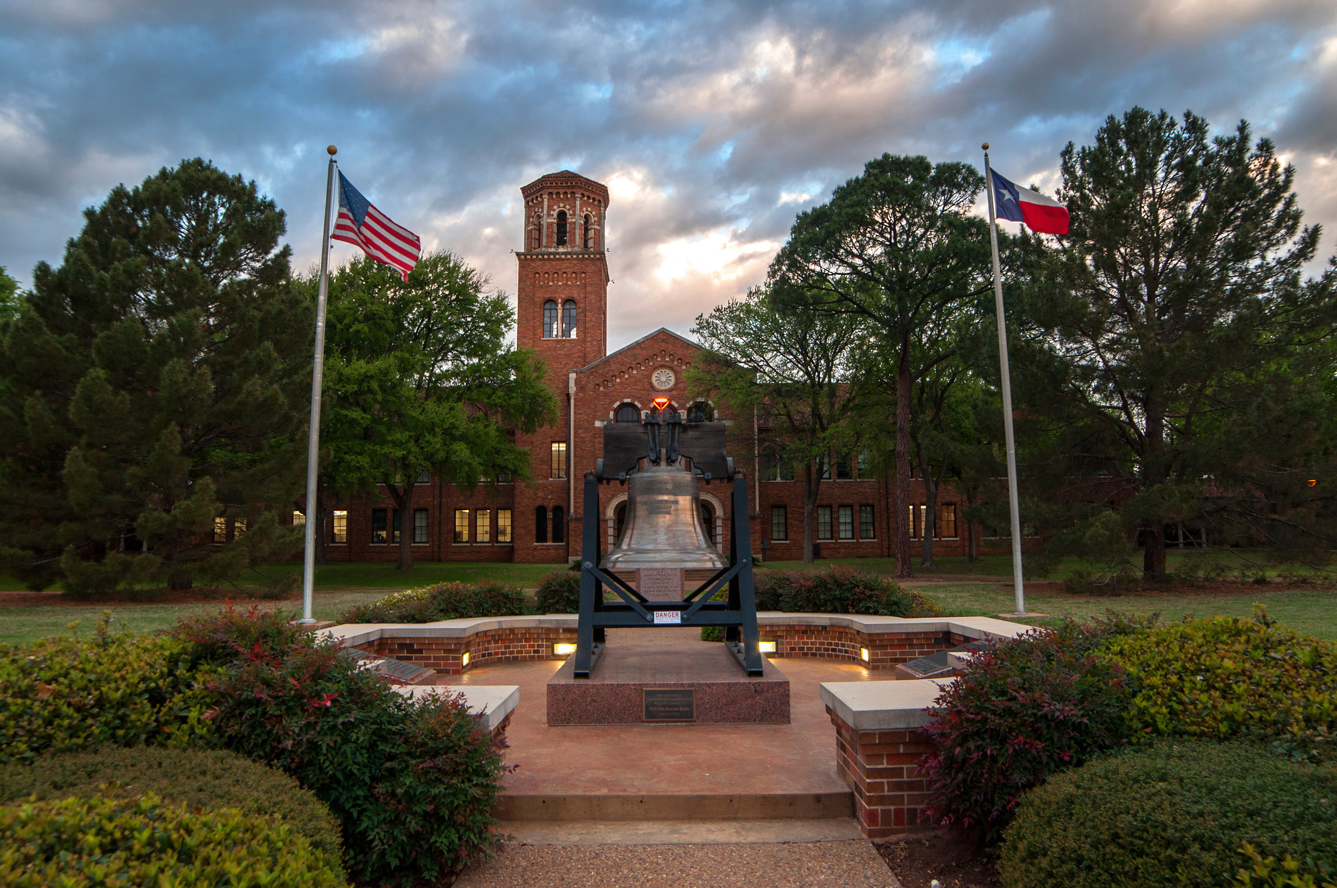
255 acre campus
16:1
student-to-faculty ratio
6,000 average enrollment
100+ student organizations
Small enough to know your classmates, yet large enough to get the full college experience!

Slide 25
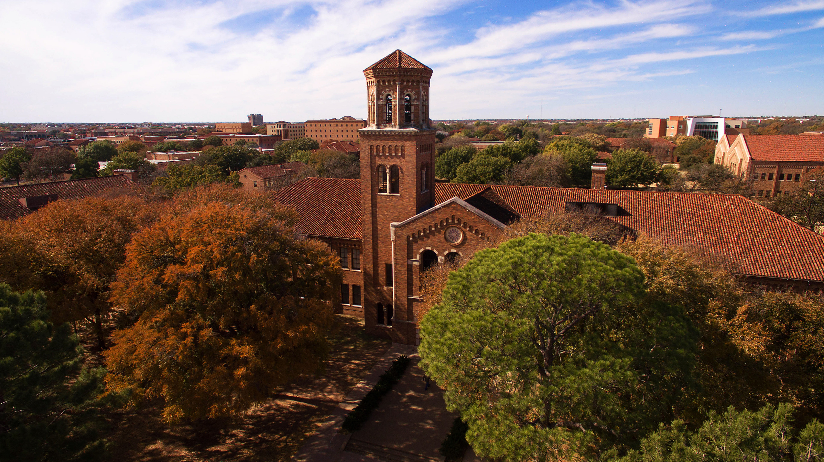
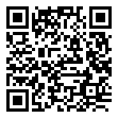
CAMPUS VISITS
Daily Tours
Saturday Tours
Mustangs Rally
Monday - Friday
10 a.m.
2 p.m.
Select Saturdays:
December 2, 2023
February 17, 2023
March 23, 2023
May 18, 2023
Our preview/open house style event for prospective and admitted students!
Fall: 10/28/2023
Spring 3/2/2024

Slide 26
Cost of Attendance 23-24
Based on Texas residency & 15 credit hours per semester
Tuition & Fees | Room | Meal Plan | Total PER YEAR
$9,776 (15 credit hours) | $5,385 (Killingsworth Hall) | $2,177 (Platinum) | $17,338 (estimated)

Slide 27
Cost of Attendance Estimates
  Average two-year college
    $16,788
  Average private university
    $75,360

Slide 28
REDWINE HONORS PROGRAM
 | Redwine Scholar | Redwine Honors Scholar | Redwine Presidential Scholar
Scholarship | $2000 a year | $4000 a year | $7000 a year
GPA | 3.25 or higher | 3.25 or higher | 3.50 or higher

Slide 29

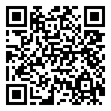
PRIDDY
SCHOLARS
  Family must have an Adjusted Gross Income of $50,000 to $125,000
  Must submit FAFSA for the following Fall semester
  Must be a first-generation student. Considered first-generation if neither parent/guardian graduated with a four-year college degree.
  Graduate high school with a 3.0 GPA or higher
  Application deadline of April 1.
15 recipients each year.
Full Tuition and Residential Funding.
Coverage of tuition, books, room, board, and study abroad.
Four-year award.

Slide 30
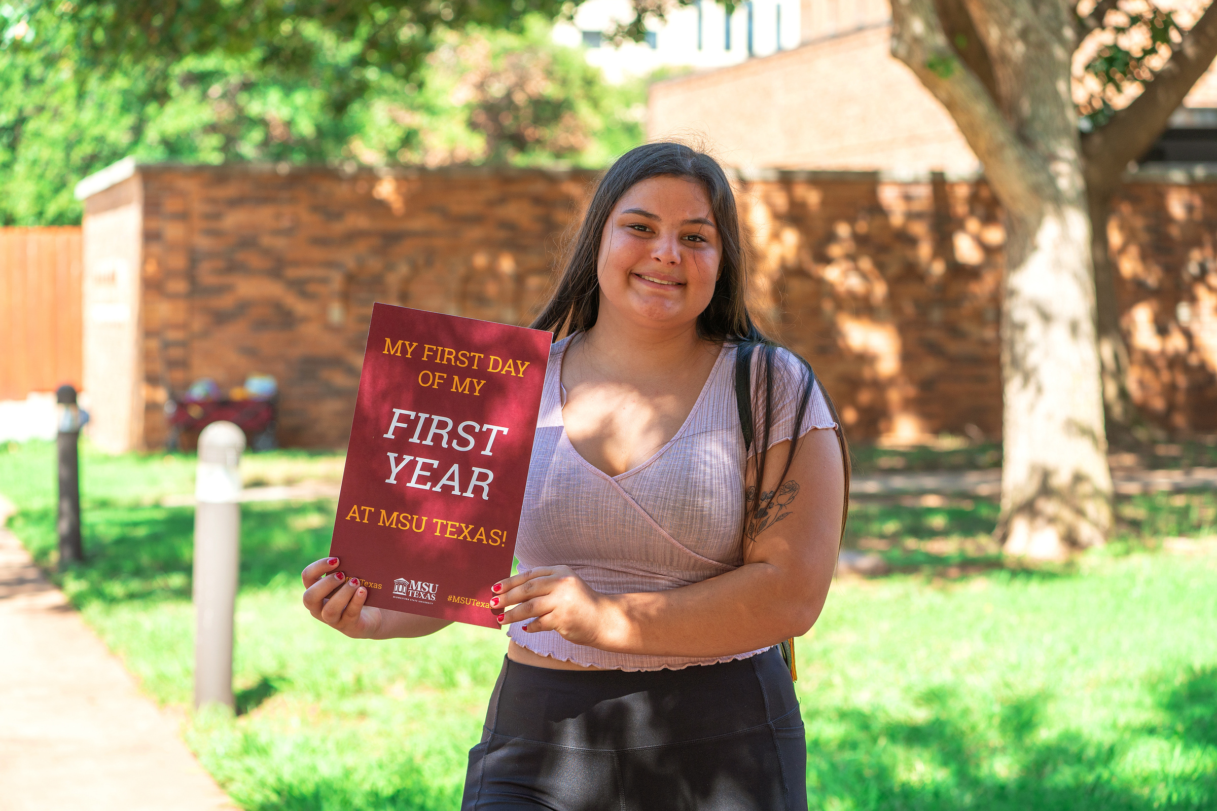
Becoming a Mustang:
Admissions Requirements
GPA Requirements
3.0 - 4.0 GPA
2.75 - 2.99 GPA
2.5 - 2.74 GPA
Rank
Top 25% of Class
Test/Rank Requirements
2nd Quarter AND 1070 SAT or 21 ACT
3rd Quarter AND 1140 SAT or 23 ACT
4th Quarter AND 1180 SAT or 24 ACT
Admission Pathway
Automatic Admission
Unconditional Admission
Conditional Admission
Automatic Admission
Unconditional Admission
Unconditional Admission
Unconditional Admission

Slide 31


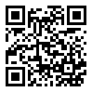
How to apply:
  Visit ApplyTexas.org
  Create an account
  Start a new application
    Four year university
    US Freshman
    Midwestern State University
    Entry term (Fall/Spring/Summer)
  Complete US Freshman questions
  Complete questions specific to MSU
    You will need your high school GPA/graduation information
  Submit!

Slide 32

MSU Texas: A worthy investment
Baylie Bradshaw, Admissions Counselor
(940)397-4078
baylie.bradshaw@msutexas.edu

Slide 33
Helpful Websites
MSU Texas Financial Aid Office
(940) 397-4214
  https://msutexas.edu – MSU Texas
  https://msutexas.edu/finaid – MSU Texas Financial Aid
  http://www.collegeforalltexans.com – state-specific information about higher education, financial aid
  https://studentaid.gov - federal site regarding student financial aid

